Slide 1
Church Member Reactions to Religious Disaffiliation: Implications of Religious Orientation
Alexander Larson, M.A.
Loma Linda University
AHSRA Conference 2017

Slide 2
Presentation Overview
Introduction: Context and Literature Review
Methods: Instruments and Procedure
Results: Statistical analyses and patterns
Discussion: Reintegration and considerations

Slide 3
Introduction
Context: Ryan Bell’s Year without God
Christian reactions online
Rebellious traits
Lack of religious integrity
Mental illness
Atheist reactions to Christian reactions
A normative experience for any public disaffiliate
Proof of “caustic nature of religion”
www.npr.org
Bell (2013, December 28)
Bell (2013, December 31)
Bell (2015, January 8)
Firma (2014, December 29)
Mackintosh (2015, January 1)
Relevant Magazine (2015, January 4)
Koonse (2014, December 23)

Slide 4
Religious Disaffiliation
Disengaging from religious behaviors
Belief
Prayer
Church attendance
Studying sacred text
Disengagement from religious community
Rejecting the communal label
Extent of network
Bahr & Albrecht (1989)
Brinkerhoff & Burke (1980)
Hunsberger & Altemeyer (2006)
Pew Forum (2012, 2015)
Roozen (1980)

Slide 5
Religious Fundamentalism
“[Fundamentalism comprises] the belief that there is one set of religious teachings that contain the fundamental, unchangeable truth that must be defended from the forces of evil.” – Altemeyer & Hunsberger (2004)

Slide 6
Religious Fundamentalism
Revised Religious Fundamentalism Scale
12 items, 9-point scale
Sample reliability: α = .916
Valid: 472/634 = 74.4%
Excluded*: 162/634 = 25.6%
Descriptives:
M = 4.856, SD = 1.282, min = 2.905, max = 7.125
Skewness: -.162, Kurtosis: -.724

Slide 7
Religious Fundamentalism
“Fundamentalist” Profile:
Moderate racial prejudice, high homosexual prejudice
Tend to be ethnocentric and insular
Help those who identify similarly
Relation to “right-wing authoritarianism” (r = .68)
Submission to authority
Aggression towards disobedience/out-groups
Adhering and enforcing traditional values
Allport & Ross (1967) Altemeyer & Hunsberger (2005)
Altemeyer & Hunsberger (1992) Gribbins & Vandenberg (2011)
Altemeyer & Hunsberger (2004) Altemeyer (1988)
Laythe, Finkel, Bringle & Kirkpatrick (2002) Shaffer & Hastings (2007)
Fulton, Maynard & Gorsuch (1999)

Slide 8
Religious Quest
“[Religious quest comprises] the readiness to face existential questions without reducing their complexity, self-criticism, perception of religious doubt as positive, and openness to change.” – Batson & Schoenrade (1991b)

Slide 9
Religious Quest
Quest Scale (12 items, 9-point Likert)
Sample reliability: α = .822
Valid: 464/634 = 73.2%
Excluded: 170/634 = 26.8%
Descriptives:
M = 5.948, SD = 1.070, min = 3.933, max = 7.209
Skewness: -.637, Kurtosis: .477
Research correlations:
Religious fundamentalism: r = -.44
Subjective well-being: r = -.22
Complex thinking about religious questions: r = .36
Batson & Schoenrade (1991b)

Slide 10
Religious Quest
“Quester” Profile:
Tend to reject absolutistic thinking styles
Open to challenging their own belief system
Inconsistent church attendance
Likely to engage in helping behaviors that require personal investment (beyond social desirability factors)
Less likely to rely on authority when judging moral behavior
Show willingness for purposeful exposure to opposing belief systems
Tend to have more religious distress and anxiety
Genia (1996) Batson & Schoenrade (1991)
Batson et al. (1989) McFarland & Warren (1992)
Sapp & Jones (1986) Messay, Dixon, & Rye (2012)
Barrett et al. (2005)

Slide 11
Religious Disaffiliate Attribution Scale
Respondents with high scores on the Religious Disaffiliate Attribution Scale may tend to view religious disaffiliation as a spiritually dangerous action, caused by deficits in spiritual character of the disaffiliate—deficits that a “true believer” would not have. (Larson, 2016)

Slide 12
Religious Disaffiliate Attributions
Religious Disaffiliate Attribution Scale
13 items, 7-point Likert
Sample reliability: α = .901
Valid: 498/634 = 78.5%
Excluded: 136/634 = 21.5%
Descriptives:
M = 2.311, SD = .957, min = 1.000, max = 5.69
Skewness: .962, Kurtosis: .710

Slide 13
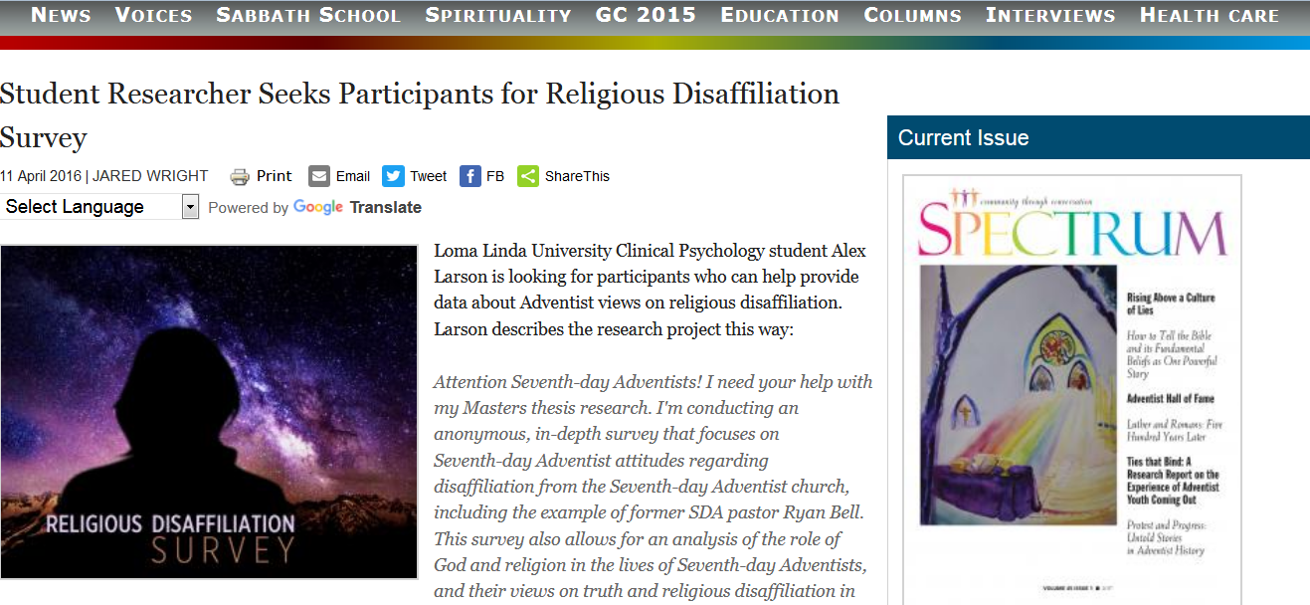
Data Collection
Qualtrics Survey Software
Advertising:
Spectrum Magazine
Facebook (snowball)
Data collection: April 4 – April 24, 2016
636 total respondents; 76% completed survey

Slide 14
Purpose of Research
Analyze relatedness of constructs
Examine the influence of religious orientation on negative reactions towards religious disaffiliates
Examine the relatedness of religious orientation on perceived social identity

Slide 15
Results
Analyze relatedness of constructs
Pearson correlation
 | RDAS | RRFS
RRFS | .633 N = 481 | --
RQS | -.539 N = 475 | -.524 N = 474
Note: All correlations were significant at the p < .001 level (2-tailed)

Slide 16
Results
Examine the influence of religious orientation on negative reactions towards religious disaffiliates
Average RDAS scores
Average personal reaction scores
Average overall disapproval of religious disaffiliation in general
Independent samples t-test

Slide 17
Results
t(312) = 15.997, p < .001; r = .67

Slide 18
Results
t(299) = 14.450, p < .001; r = .64

Slide 19
Results
t(312) = 12.219, p < .001; r = .56

Slide 20
Results
Examine the relatedness of religious orientation on perceived social identity
Pearson Correlation
 | RRFS | RQS
Discrepancy with GC | -.709 N = 455 | .486 N = 455
Discrepancy with “Most Adventists” | -.636 N = 451 | .396 N = 451
Discrepancy with Ryan Bell | .568 N = 453 | -.420 N = 453
Note: All correlations were significant at the p < .001 level (2-tailed)

Slide 21
Implications
How we think about religion contributes to what we think about others—particularly those who have left us
How we think about religion is often related to how we understand our relationship to others and our authority figures
Religious disaffiliation is an important issue for us to address amongst ourselves…

Slide 22
Implications
Note: of those who responded:
Yes: 65%
No: 35%

