Slide 1

Religious Motivation Varies by Engagement and Generational Cohort
Karl G. D. Bailey & Duane C. McBride
5th Annual AHSRA Meeting
Loma Linda, CA
May 19, 2017

Slide 2

Student Researchers
*Chinyere Sampson
Arian C. B. Emanuel
*Cheryl B. Simpson Collatz
*Paola Caceres
*Kayla Schenkelberg
*Holly Wilkerson
*Aleksey Korenichenko
*Heather Moore
*Charles Abreu
Research
Colloquium:
L. Monique Pittman
Vanessa Corredera
Ante Jerončić
Research Colleagues
Duane McBride
Cooper Hodges*
Petr Cincala
Alina Baltazar
René Drumm
Shannon Trecartin
Harvey Burnett
The ASTR Office
Family
Rudolph, Arlene, & Kieren
Rosemary, Lilianora & Annalise

Slide 3
Why do people engage in religious behaviors?
Notes:
Motivation: factors that lead people to act.
Ed Deci and Richard Ryan note that there are many possible different types of motivation, and that motivation involves “energy, direction, persistence, and equifinality--all aspects of activation and intention”

Slide 4
Intrinsic and extrinsic motivation is one of the most common frameworks used to think about religious motivation.
Allport, G. W. & Ross, J. M. (1967). Personal religious orientation and prejudice. Journal of Personality and Social Psychology, 5, 432-443.
Notes:
Intrinsic Religious Orientation or Intrinsic Faith (mean = 37.2; SD = 5.8): religion is a “master motive in life, an end in itself, a religion to be lived and not just used” (Hill, 2005).
Extrinsic Religious Orientation or Extrinsic Faith (mean (Ep + Es) = 25.6, SD = 5.7): religion is “for one’s own interest, a means to some other end, a religion to be used rather than lived” (Hill, 2005). Subdivided into personally oriented and socially oriented.
Originally developed to explain the minority of religious individuals who are not more prejudiced than non-religious, even though religious individual are more prejudiced overall. Found that Extrinsic were more prejudiced than Intrinsic, but that people who were both high extrinsic and high intrinsic (indiscriminately proreligious) were the most prejudiced of all.
Note that these are orthogonal
Extrinsic has a negative gloss.

Slide 5
The modern formulation for the intrinsic/extrinsic framework divides extrinsic motivation into personally oriented and social oriented
Gorsuch, R. L., & McPherson, S. E. (1989). Intrinsic/extrinsic measurement: I/E-Revised and single-item scales. Journal for the Scientific Study of Religion, 28, 348-354.

Slide 6
Intrinsic
I enjoy reading about my religion.
It is important to me to spend time in private thought and prayer.
I have often had a strong sense of God’s presence.
I try hard to live all my life according to my religious beliefs.
Intrinsic Reversed
*It doesn’t much matter what I believe so long as I am good.
*Although I am religious I don’t let it affect my daily life.
* Although I believe in my religion, many other things are more important in life.
Extrinsic Social
I go to church because it helps me to make friends.
I go to church mostly to spend time with my friends.
I go to church mainly because I enjoy seeing people I know there.
Extrinsic Personal
I pray mainly to gain relief and protection.
What religion offers me most is comfort in times of trouble and sorrow.
Prayer is for peace and happiness.

Slide 7
Socially Oriented:
I go to church because it helps me to make friends.
I go to church mostly to spend time with my friends.
I go to church mainly because I enjoy seeing people I know there.
Personally Oriented:
I pray mainly to gain relief and protection.
What religion offers me most is comfort in difficult times.
Prayer is for peace and happiness.
Gorsuch, R. L., & McPherson, S. E. (1989). Intrinsic/extrinsic measurement: I/E-Revised and single-item scales. Journal for the Scientific Study of Religion, 28, 348-354.
Notes:
However, these are perfectly reasonable motivations for religion.

Slide 8
Most people act to achieve goals. The degree to which those goals are internalized changes the nature of motivation towards those goals.
increasing wholeheartedness
external regulation
introjection
identification
integration
reward & punishment
guilt, shame, impression management
means-ends values
part of core self
Deci, E. L. & Ryan, R. M. (2008). Facilitating optimal motivation and psychological well-being across life’s domains. Canadian Psychology, 49, 14-23.
Notes:
so it is possible for people to share a goal, but be motivated in different ways, depending on the internalization of that goal.

Slide 9
Full internalization drives thriving; partial internalization (introjection) thwarts thriving.
Ryan, R. M., Rigby, S., & King, K. (1993). Two types of religious internalization and their relations to religious orientations and mental health. Journal of Personality and Social Psychology, 65, 586-596. doi:10.1037/0022-3514.65.3.586

Slide 10
incomplete segmentation: Sabbath-keeping because of social pressure; frequent self-interruptions of Sabbath rest by cares and concerns of the week.
prescribed meaning: Sabbath-keeping is a means for engaging in rest and community that is unavailable during the week.
integrated Sabbath: Sabbath-keeping informs all aspects of life and transforms life throughout the week.
Bailey, K. G. D., & Timoti, A. C. B. (2015). Delight or distraction: An exploratory analysis of Sabbath-keeping internalization. Journal of Psychology & Theology, 43, 192-203.
Notes:
Prescribed meaning and integrated Sabbath tend to co-occur among Adventists. This suggests that for Adventists, the community (social motivations) and internalization might not be entirely unrelated.

Slide 11
In the 2013 Church Member Survey, does the intrinsic-extrinsic framework best fit the data, or do the wholeheartedness-coercion frameworks fit better?
Are there differences in the relationship between motivation and religious behaviors across adult generational cohorts?

Slide 12
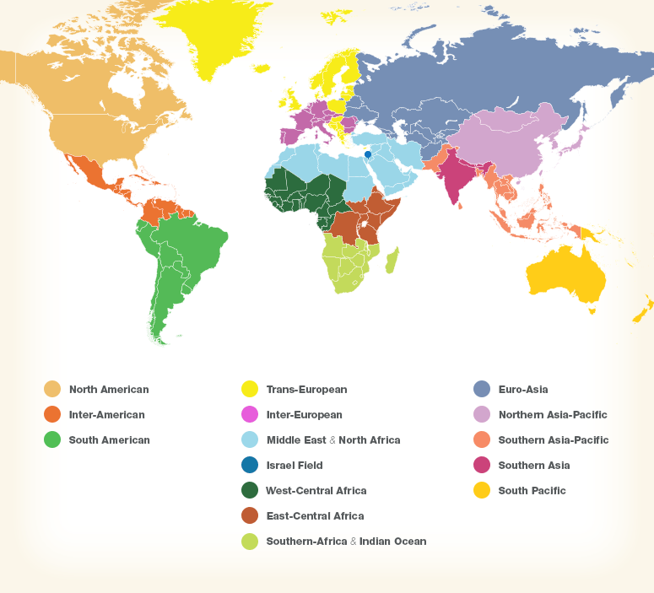

Slide 13
Division
Age Cohort
Church Attendance
N = 1229 x 4
Sex
Born SDA?
Family Worship
Notes:
Overall N = 8198
Other N = 1639 or 1643.
Note age ranges for different adult categories: 18-25, 26-40, 41-55, 55+ (less responsibility for children)

Slide 14
Gorsuch & McPherson, 1989 model
Fit Indices
CFI = .699 (threshold: > .95)
TLI = .630 (threshold: > .95)
RMSEA = .108 (threshold: < .05)
SRMR = .125 (threshold: < .08)
Schreiber, J. B., et al. (2006). Reporting structural equation modeling and confirmatory factor analysis results: A review. Journal of Educational Research, 99, 323-337.
Notes:
CFI: Comparative Fit Index
TLI/NNFI: Tucker-Lewis Index; non-normed fit index
RMSEA: root mean square error of approximation
SRMR: standardized root mean square residual

Slide 15
factor analysis best practices
(Bandalos & Boehm-Kaufman, 2009; Costello & Osborne, 2005)
CFA conducted using the cfa function using the lavaan package (v. 0.5-23.1097) in R 3.3.4
EFA conducted using the fa function using the psych package (v. 1.7.5) in R 3.3.4
principal axis factoring
direct oblimin rotation
multiple robust heuristics for number of factors
(scree plot; parallel analysis; MAP test; ICLUST)
test a range of solutions; identify the best solution
  5 items loading greater than 0.5 on each factor
  minimize cross-loading
  remove low- and non-loading items
    multiple measures of internal consistency
    (Cronbach’s α, Revelle’s β, and McDonald’s ωh)
Notes:
Original range: 3-7 factors—reporting 1-5 (6 and 7 had very small factors)

Slide 16
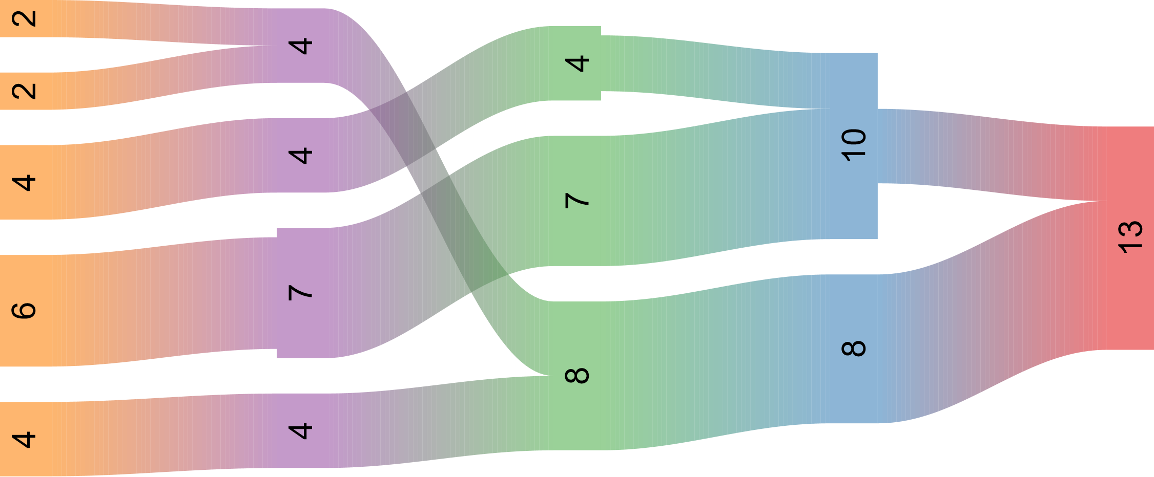
5 Factors
4 Factors
3 Factors
2 Factors
1 Factors
How are different factor solutions related?
Notes:
Liberal inclusion criterion > .3
Some ‘stable’ factors are made up of relatively weakly-related items.
SOCIAL RELIGIOUS MOTIVATION
IDENTIFIED RELIGIOUS MOTIVATION
Each node represents the number of items in that factor in that solution. River paths show how items move with the number of factors.
5 & 7 items > .4 in the 8 and 10 item factors for 2 factor solution respectively. The third factor in 3 factor solution is weak and doesn’t meet criterion.
Reduced to 5 + 5 items (all > .5) to simplify interpretation. Alphas (SOC = .78, ID = .67). Betas (SOC = .67, ID = .60), Hierarchical omegas (SOC = .66; ID = .59). CFA fit is OK, but there is not strong factor saturation. Could mean construct is more multidimensional, but items are poor/noisy.
Scree, Velicer’s MAP, and Revelle’s ICLUST all agree on 2 factors for all EFA samples (1 + 3 test). The Parallel analysis still suggests 3, which is consistent with the low omega.

Slide 17
FACTOR 1: Social Religious Motivations
I go to church mostly to spend time with my friends. (Es)
I go to church mainly because I enjoy seeing people I know there. (Es)
Sometimes I have to disregard my religious beliefs because of what people might think of me. (-/Es)
It doesn’t much matter what I believe so long as I am good. (I*)
I pray mainly because I have been taught to pray. (-)
FACTOR 2: Identified Religious Motivations
My religion is important because it answers many questions about the meaning of life. (-/I)
I try hard to live according to my religious beliefs. (I)
It is important to me to spend time in private thought and prayer. (I)
I enjoy reading about Seventh-day Adventism. (I)
I have often had a strong sense of God’s presence. (I)

Slide 18
Fit indices show good or adequate fit, depending on the sample.

Slide 19
Goodness of fit is stable across multiple fit indices and samples—a sign of a stable model.
Notes:
Calculated scale scores.

Slide 20
Is the frequency of family worship related to motivation, life-long Adventist status, or adult age cohort?
Notes:
Some further work to be done with last two samples, but going to combine full sample + SSD for this analysis because the small cell size for adults makes the data quite volatile.

Slide 21
Change in odds of high frequency of family worship:
Change in odds of high frequency of church attendance:
Adult vs. Older Adult | x1.04
Young vs. Older Adult | x0.80*
Emerging vs. Older Adult | x0.48*
Social Motivation | x1.23*
Identified Motivation | x1.83*
Born SDA | x1.32*
Adult vs. Older Adult | x0.98
Young vs. Older Adult | x0.75*
Emerging vs. Older Adult | x0.61*
Social Motivation | x0.84*
Identified Motivation | x1.63*
Born SDA | x1.18*

Slide 22
Change in odds of high frequency of family worship:
Change in odds of high frequency of church attendance:
Adult vs. Older Adult | x1.04
Young vs. Older Adult | x0.80*
Emerging vs. Older Adult | x0.48*
Social Motivation | x1.23*
Identified Motivation | x1.83*
Born SDA | x1.32*
Adult vs. Older Adult | x0.98
Young vs. Older Adult | x0.75*
Emerging vs. Older Adult | x0.61*
Social Motivation | x0.84*
Identified Motivation | x1.63*
Born SDA | x1.18*

Slide 23
Change in odds of high frequency of family worship:
Change in odds of high frequency of church attendance:
Adult vs. Older Adult | x1.04
Young vs. Older Adult | x0.80*
Emerging vs. Older Adult | x0.48*
Social Motivation | x1.23*
Identified Motivation | x1.83*
Born SDA | x1.32*
Adult vs. Older Adult | x0.98
Young vs. Older Adult | x0.75*
Emerging vs. Older Adult | x0.61*
Social Motivation | x0.84*
Identified Motivation | x1.63*
Born SDA | x1.18*

Slide 24
⁶ “And these words which I command you today shall be in your heart. ⁷ You shall teach them diligently to your children, and shall talk of them when you sit in your house, when you walk by the way, when you lie down, and when you rise up. ⁸ You shall bind them as a sign on your hand, and they shall be as frontlets between your eyes. ⁹ You shall write them on the doorposts of your house and on your gates.
(Deuteronomy 6:6-9)

Slide 25
Being born into the SDA church increases the odds of higher rates of family worship.
However, family worship is drastically reduced overall in younger adult cohorts.

Slide 26
On the other hand, both social and identified motivation have a positive relationship with frequency of family worship—even in the youngest adult cohort.
Notably, both the youngest adults and the oldest adults are highly socially motivated when they are highly engaged in family worship.

Slide 27
The Seventh-day Adventist Church might consider designing inter-generational programs to build relationships that meet the social needs of the oldest and youngest adult church members.
Discipling—the process of teaching the internalization of the Gospel—has a profound effect on the practices that sustain and transmit faith within the family.

Slide 29
Born SDA?
Change in odds of high frequency of family worship:
Adult vs. Older Adult | x1.04
Young vs. Older Adult | x0.80*
Emerging vs. Older Adult | x0.48*
Social Motivation | x1.23*
Identified Motivation | x1.83*
Born SDA | x1.32*
Notes:
N = 15868 – about 1600 missing depending on analysis.
SSD is now the majority.

Slide 30
Born SDA?
Change in odds of high frequency of church attendance:
Adult vs. Older Adult | x0.98
Young vs. Older Adult | x0.75*
Emerging vs. Older Adult | x0.61*
Social Motivation | x0.84*
Identified Motivation | x1.63*
Born SDA | x1.18*

Slide 31
Born SDA?
Change in odds of high frequency of family worship:
Adult vs. Older Adult | x1.04
Young vs. Older Adult | x0.80*
Emerging vs. Older Adult | x0.48*
Social Motivation | x1.23*
Identified Motivation | x1.83*
Born SDA | x1.32*
Notes:
Note that emerging and older adults are highly social motivated when they are engaging in high frequencies of family worship.

Slide 32
Born SDA?
Change in odds of high frequency of church attendance:
Adult vs. Older Adult | x0.98
Young vs. Older Adult | x0.75*
Emerging vs. Older Adult | x0.61*
Social Motivation | x0.84*
Identified Motivation | x1.63*
Born SDA | x1.18*

